Slide 3
Notes:
Raise your hand if you used any of these items in the last… …month …week …day
Where do you think they are now? (Get students’ suggestions.)

Slide 4
Notes:
Some plastics are recycled, but it’s estimated that 12.7 million tonnes end up in our oceans every year. That’s a rubbish truck load every minute.

Slide 5
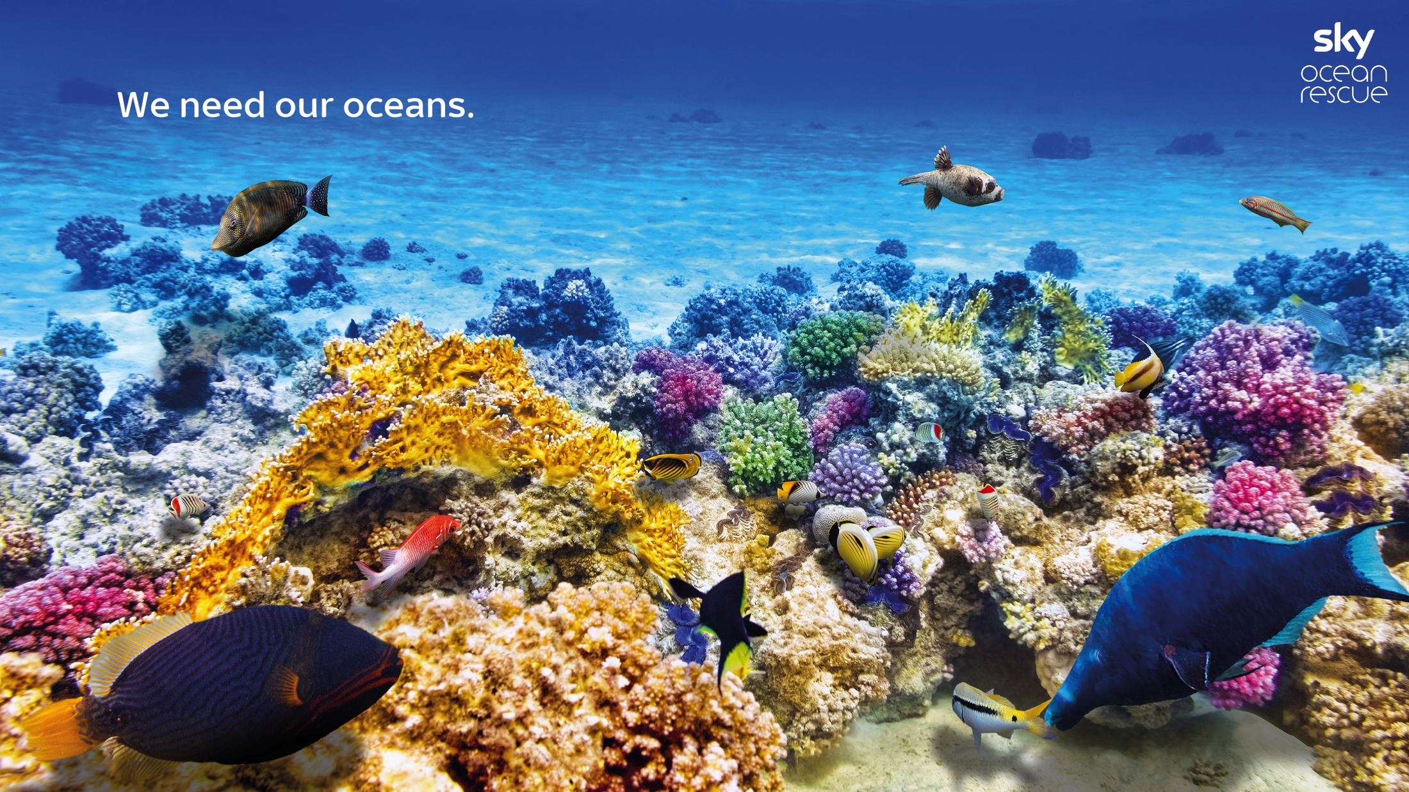
Notes:
We can’t underestimate how important oceans are to our survival.

Slide 6
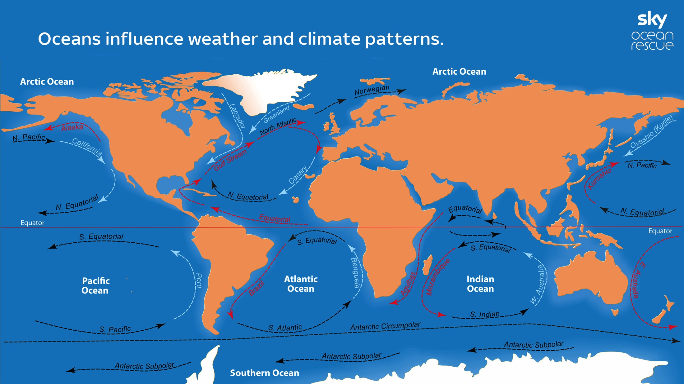
Notes:
Most of us know that oceans provide food and are home to millions of different species. But you might not be aware of some of the other roles that oceans play in sustaining life on the planet. For example, in regulating climate and weather.
The sun heats up the surface of the ocean, then ocean currents move the warm water to different places around the Earth. This affects the weather and climate in those places.

Slide 7
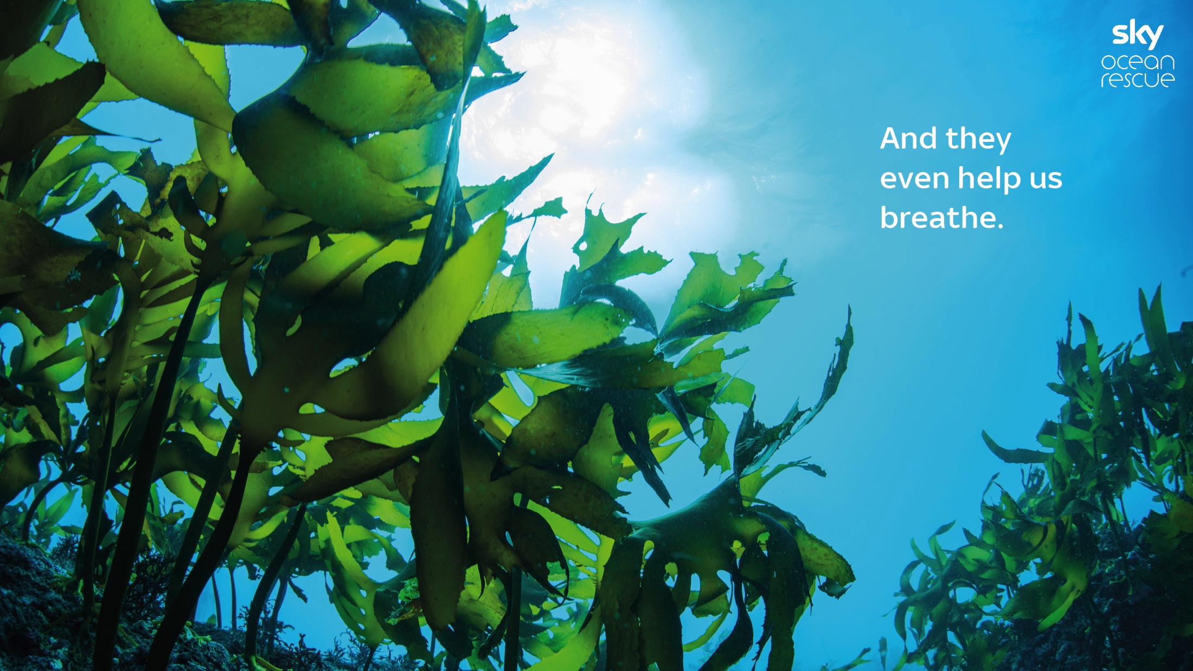
Notes:
Scientists think that up to 70% of the oxygen we breathe comes from tiny ocean plants called phytoplankton.

Slide 8
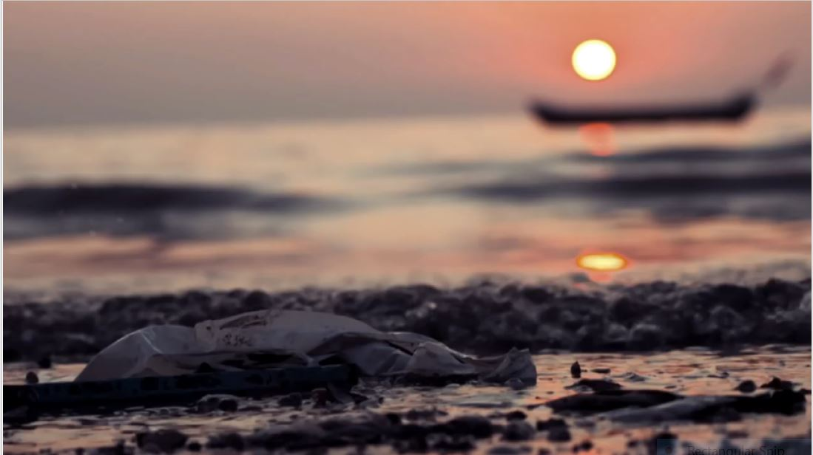
Notes:
Let’s find out more about the issue. Play video: https://youtu.be/12axlMbqDtM

Slide 9
Notes:
So, we’ve seen some of the damage that plastics do to our oceans. But worst of all are single-use plastics. These are plastic items that we use only once.

Slide 10
Notes:
(Read slide. Put your hand up if you think it’s 10%... 25%...40%.)

Slide 11
Notes:
If you guessed 40%, you’re right. It’s shocking, isn’t it – nearly half of the plastic we use is only used once… but it can stay in the ocean for hundreds of years!

Slide 12
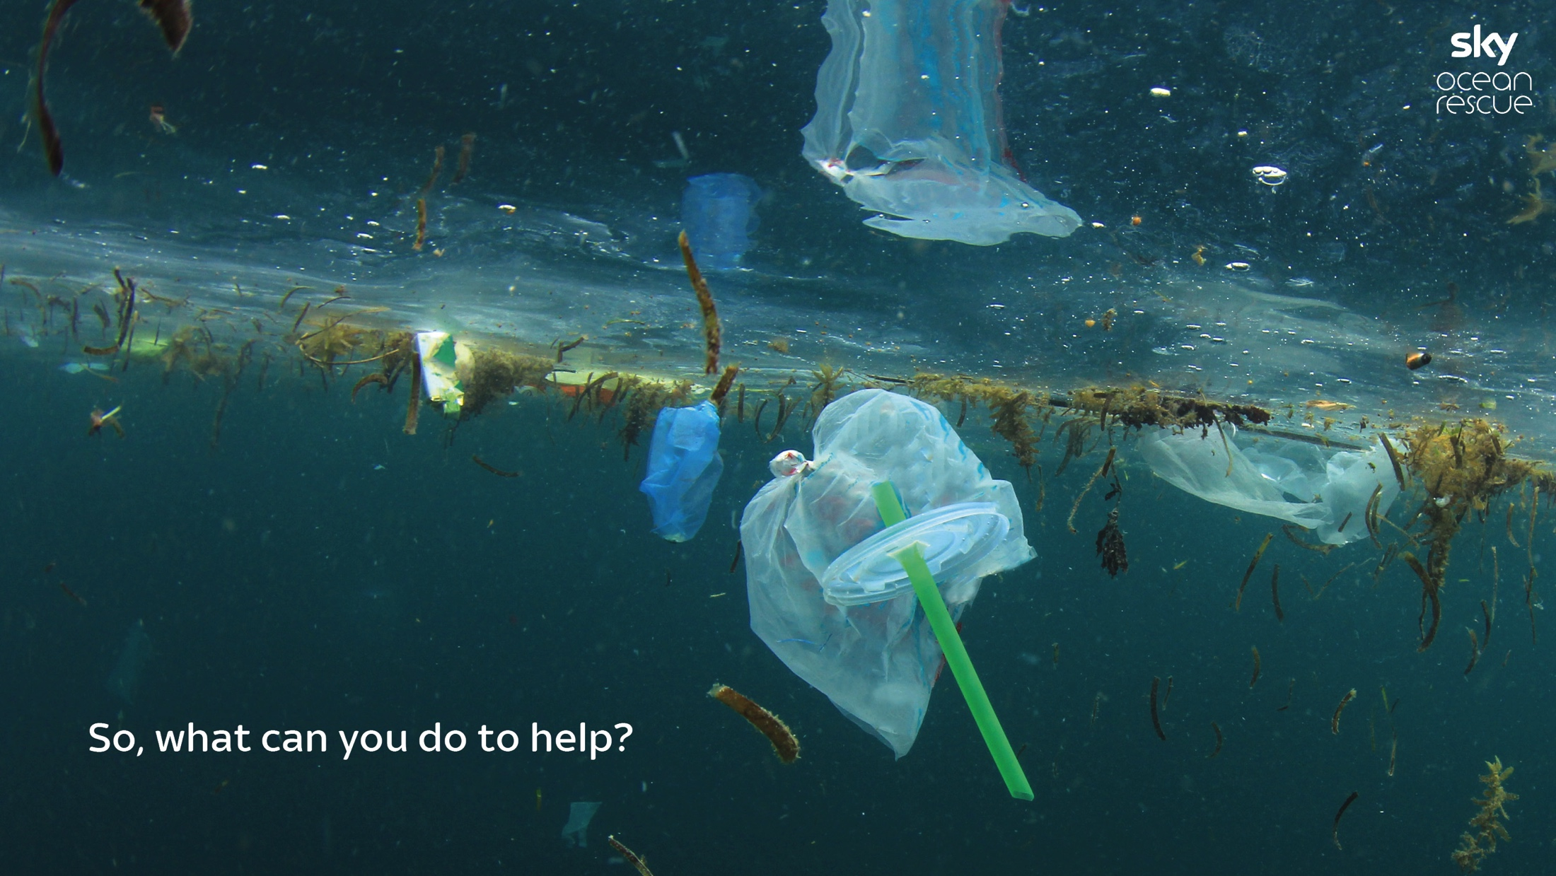
Notes:
Every one of us has the power to make a difference to the amount of plastic ending up in our oceans every day. We’re going to look at three ways that you can help, by Passing On Plastic.

Slide 13
Notes:
Plastic bottles are the third worst plastic polluter of the ocean and more than 13 billion single-use plastic bottles are sold in Britain each year.

Slide 14
Notes:
Use of plastic supermarket bags has dropped 85% since the 5p charge was introduced.

Slide 15
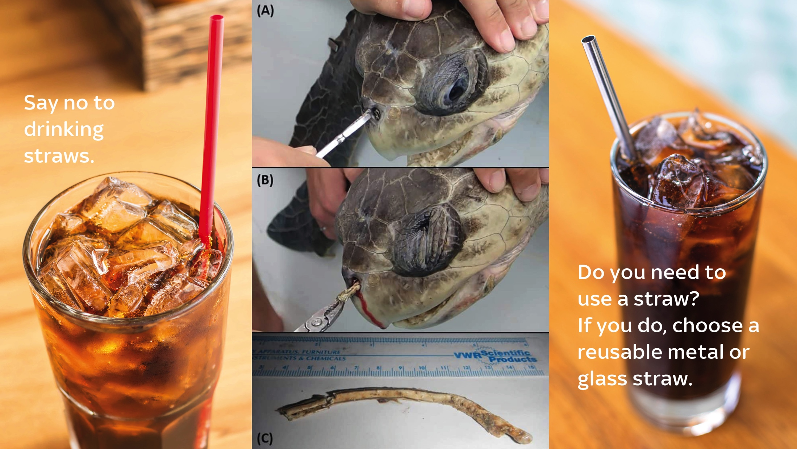
Notes:
It is estimated that we use 8.5 billion straws a year, here in the UK. They are one of the top 10 items found in beach clean-ups.

Slide 17
Notes:
(Read slide.)

Slide 18
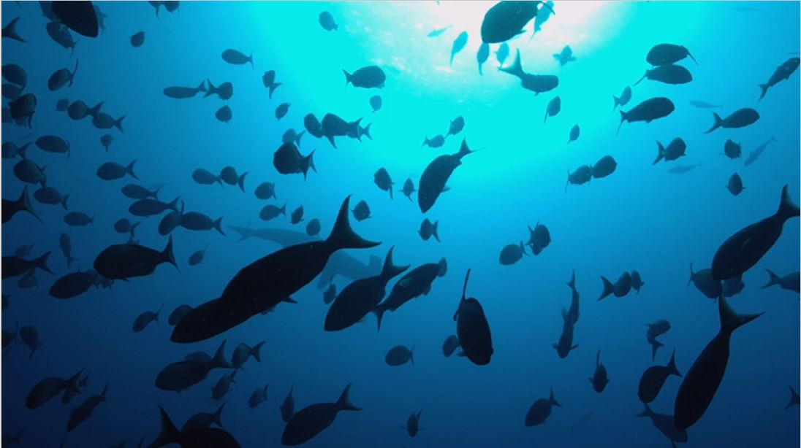
Notes:
Play video: https://www.youtube.com/watch?v=36KYD5l5A14&t=1s – Competition launch 24th January 2019 and competition closes 29th April

Slide 19
Notes:
We can make a difference. By passing on plastic, we can turn this...

Slide 20
Notes:
…back into this.

